Slide 1
CIT2C23
Agile Methodology & Design Thinking
Case Study: Ideate (30%)
Student Name (Admin No.):
Tutorial Group:
Tutor:
Submission Date:

Slide 2
Declaration of Originality
I am the originator of this work and I have appropriately acknowledged all other original sources used as my references for this work.
I understand that Plagiarism is the act of taking and using the whole or any part of another person’s work, including work generated by AI, and presenting it as my own.
I understand that Plagiarism is an academic offence
and if I am found to have committed or abetted the offence of plagiarism in relation to this submitted work, disciplinary action will be enforced.
Name and Signature of Student:
<<Replace this with Name and Signature of student>>

Slide 3
Declaration on the use of Generative AI tools for assignments
Describe how you have used Generative AI tools such as ChatGPT or Dall.E-2 in your assignment.
Show snapshots of the conversations with the AI tool (i.e., the prompts you used and the response you get from the AI tool).

Slide 4
How do you indicate the reference?
The content generated by AI tools are not retrievable except by the user who generated them, so they are considered non-recoverable sources. Although non-recoverable data or quotations in APA Style papers are usually cited as personal communications, with ChatGPT-generated text there is no person communicating. Quoting text from ChatGPT chat is therefore more like sharing the output of an algorithm, with a reference list entry and the corresponding in-text citation.
According to the official APA Style site, ChatGPT references should be cited as:
E.g. OpenAI. (2023). ChatGPT (Sep 25 version) [Large language model].
https://chat.openai.com/chat
Important Note:
Do not copy answers produced by the AI tool in totality as it is considered as plagiarism.
Do not rely on any information produced by the AI tool blindly. You should always verify the answer with other sources. Do not assume that these answers provided by the AI tool are correct.
To achieve quality outputs from the AI tool, you should provide good prompt that is clear and specific. Be precise and provide context. Avoid asking open-ended questions.

Slide 5
Introduction
This project aligns with the course objectives by giving students hands-on experience in applying Agile methodology and design thinking to a real-world problem. It will assess their practical knowledge and technical skills in design thinking, Agile processes, and project management. The assessment includes three milestones—Define, Ideate, and Prototype.
This is an individual project
You will be given various case studies and must select one that aligns with your experiences and interests. The chosen case study will be used throughout this assessment as you develop a solution to address it.

Slide 6
Assessment Components
Case Study (80%)
• Part 1: Define (20%)
• Part 2: Ideate (30% | 100 marks): Present a comprehensive design proposal for the proposed app, including journey maps, and Product Backlog with corresponding user stories and wireframes.
• Part 3: Prototype (30%)

Slide 7
Your design report must include the following:
Idea Evaluation (50 marks)
Develop a comprehensive design evaluation that includes:
User Journey Map – Illustrate the end-to-end experience of various users interacting with your proposed system.
Wireframes – Design clear visual representations of the user interface. Include at least two screens highlighting key functionalities of the proposed system. Justify your final design choice over the alternatives.
Note: You can use Figma/Miro or other tools to design the GUI, capture screenshots of your designs, and include links to the GUI.
JIRA-related activities (50 marks)
Create the Product Backlog of the proposed system in JIRA along with screenshots and explain the rationale behind its specific ordering.
Submit five User Stories with screenshots from JIRA.
All User Stories screenshots must include the following:
Description
Details
Attachments
Sub-tasks
Note: You must be prepared to explain your report and the processes involved when your tutor requests it.

Slide 8
1. Idea Evaluation (50 marks)
*Feel free to duplicate this slide if necessary
Design two separate screens, each demonstrating a key functionality of the proposed system. For each screen, provide alternative design options and explain why you chose the final design over the others.

Slide 9
1. Idea Evaluation (50 marks)
*Feel free to duplicate this slide if necessary
Distinct Screen 1: Insert screen name / functionality name
Design 1 |  | Design 2
Insert screenshot of Design 1 |  | Insert screenshot of Design 2
Elaborate on the chosen design
Chosen Design: | Indicate design 1 or 2
Explain: | Explain why a particular design was chosen over alternatives, highlighting its impact on user experience, addressing users' needs, and enhancing usability.

Slide 10
1. Idea Evaluation (50 marks)
*Feel free to duplicate this slide if necessary
Distinct Screen 2: Insert screen name / functionality name
Design 1 |  | Design 2
Insert screenshot of Design 1 |  | Insert screenshot of Design 2
Elaborate on the chosen design
Chosen Design: | Indicate design 1 or 2
Explain: | Explain why a particular design was chosen over alternatives, highlighting its impact on user experience, addressing users' needs, and enhancing usability.

Slide 11
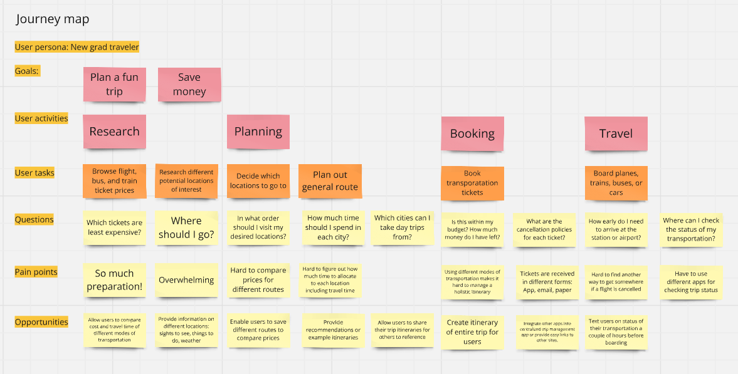
1. Idea Evaluation (50 marks)
*Feel free to duplicate this slide if necessary
List down key elements that make up a user journey map
Example:
Source: https://miro.com/customer-journey-map/what-is-a-customer-journey-map/

Slide 12
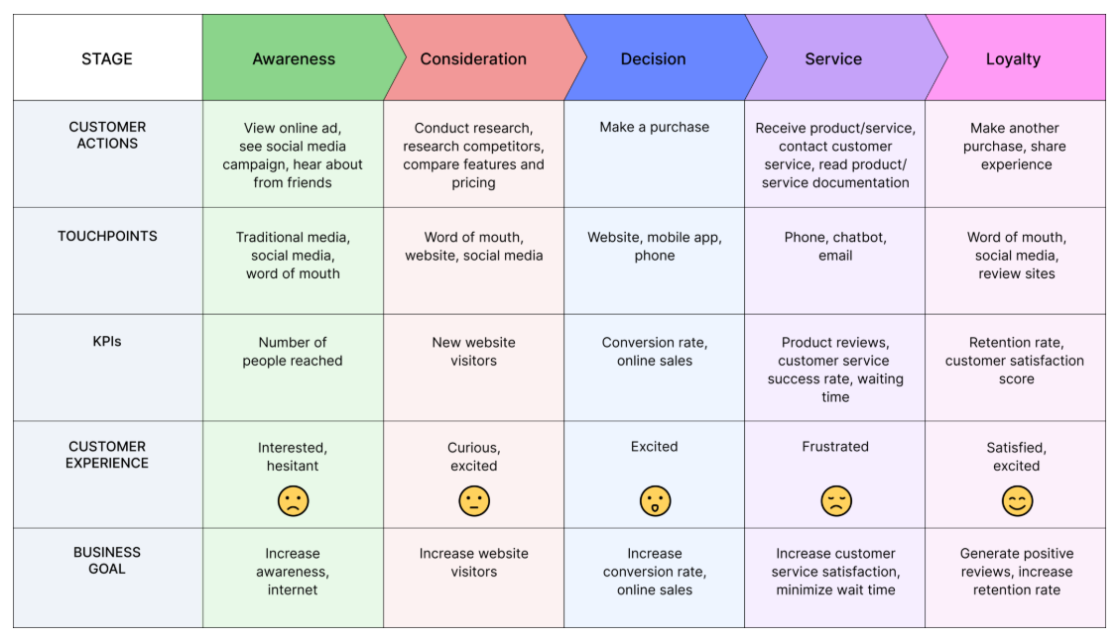
1. Idea Evaluation (50 marks)
*Feel free to duplicate this slide if necessary
User Journey Map - Illustrate the end-to-end experience of various users interacting with your proposed system.
Example:
Source: https://www.bolddesk.com/blogs/customer-journey-map

Slide 13
2. JIRA-related activities (50 marks)
*Feel free to duplicate this slide if necessary
Create the Product Backlog of the proposed system in JIRA including screenshots and explain the rationale behind its specific ordering.
Product Backlog
Insert screenshot(s) of the product backlog. If words are truncated, paste the text in as well by creating a new table below
Elaborate on the rationale behind the specific ordering
Explain on the rationale behind the specific ordering

Slide 14
2. JIRA-related activities (50 marks)
*Feel free to duplicate this slide if necessary
Provide Screenshots of at least 5 User Stories from Jira.
All User Stories must show the following:
Screenshot(s) of user story description and acceptance criteria
Screenshot(s) of attachments and sub-tasks
A screenshot of the user story details
Note: An Example of a user story with screenshots is provided in the next section

Slide 15
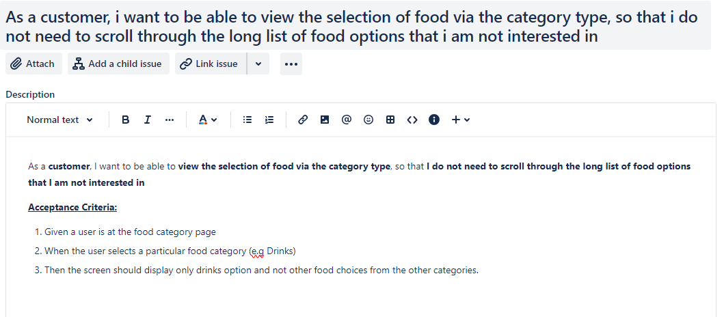
2. JIRA-related activities (50 marks) - Example
*Feel free to duplicate this slide if necessary
Example: User Story with screenshots
User Story 1
Screenshot(s) of User Story Description and Acceptance Criteria:

Slide 16
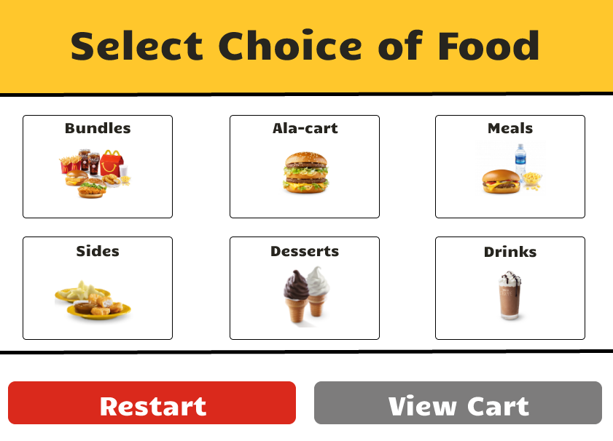
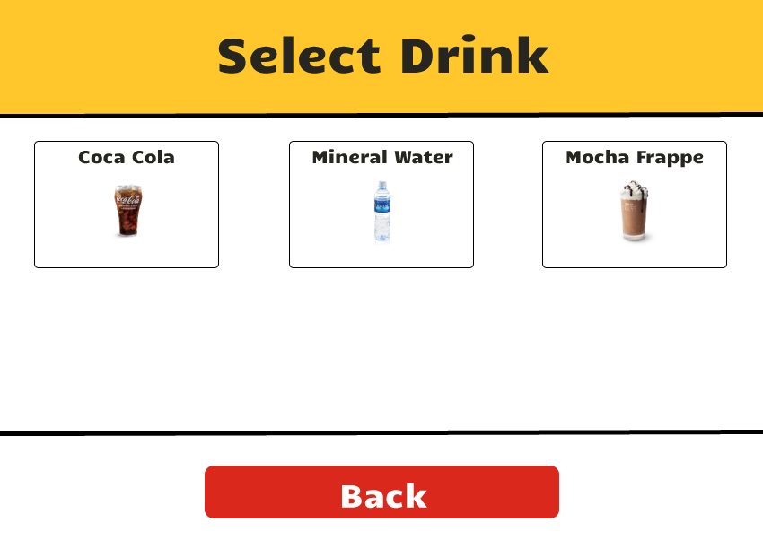
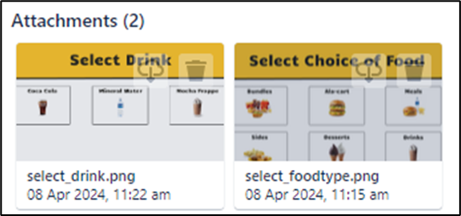
2. JIRA-related activities (50 marks) - Example
*Feel free to duplicate this slide if necessary
Example: User Story with screenshots
User Story 1
Screenshot(s) of attachments and sub-tasks

Slide 17
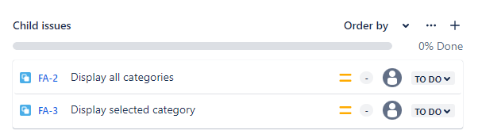
2. JIRA-related activities (50 marks) - Example
*Feel free to duplicate this slide if necessary
Example: User Story with screenshots
User Story 1
Screenshot(s) of attachments and sub-tasks

Slide 18
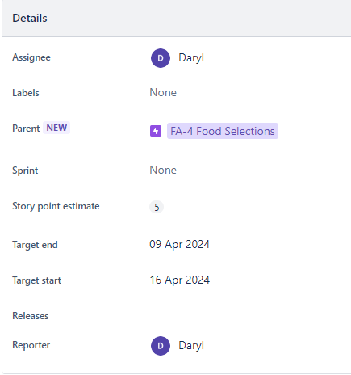
2. JIRA-related activities (50 marks) - Example
*Feel free to duplicate this slide if necessary
Example: User Story with screenshots
User Story 1
A screenshot of the user story details (Note: Details must show, Assignee, Parent (linked to Epic), Story Point Estimate, Target Start and End.)

Slide 19
References

